Slide 1
Unleashing the Power of AI Tools

Slide 2
Introduction to AI Tools
Natural Language Processing
Computer Vision
Predictive Analytics
Robotic Process Automation
Machine Learning

Slide 3

Introduction to AI Tools
Artificial Intelligence (AI) tools are becoming increasingly popular in the technology industry. These tools use machine learning algorithms to analyze and make predictions based on large amounts of data.
AI tools can be used in a variety of applications, from speech recognition to image analysis. They are particularly useful in fields such as healthcare, finance, and marketing where accurate predictions can have a significant impact.

Slide 4

Natural Language Processing
One of the most widely used AI tools is natural language processing (NLP). NLP allows computers to understand and interpret human language, including written text and spoken words.
NLP can be used for a variety of tasks, such as sentiment analysis, chatbots, and machine translation. It has applications in industries such as customer service, social media monitoring, and language education.

Slide 5
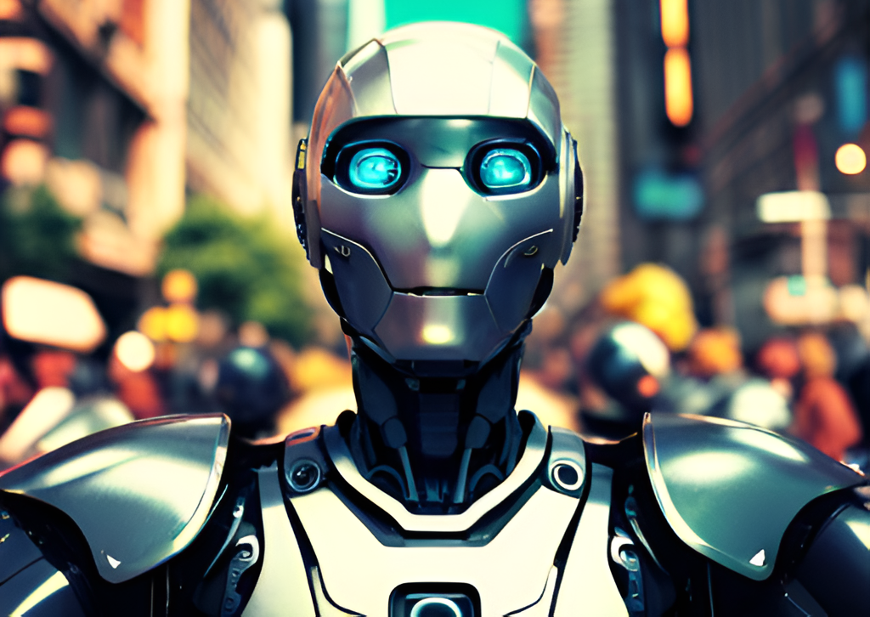
Computer Vision
Computer vision is another important application of AI tools. It involves teaching computers to interpret and understand visual information, such as images and videos.
Computer vision has many practical uses, such as object recognition, facial recognition, and autonomous vehicles. It also has applications in fields such as security, entertainment, and healthcare.

Slide 6

Predictive Analytics
Predictive analytics is a type of AI tool that uses statistical algorithms to make predictions about future events based on historical data. It is widely used in industries such as finance, healthcare, and marketing.
Predictive analytics can be used for a variety of tasks, such as fraud detection, risk assessment, and customer segmentation. It allows businesses to make more informed decisions and improve their overall performance.

Slide 7
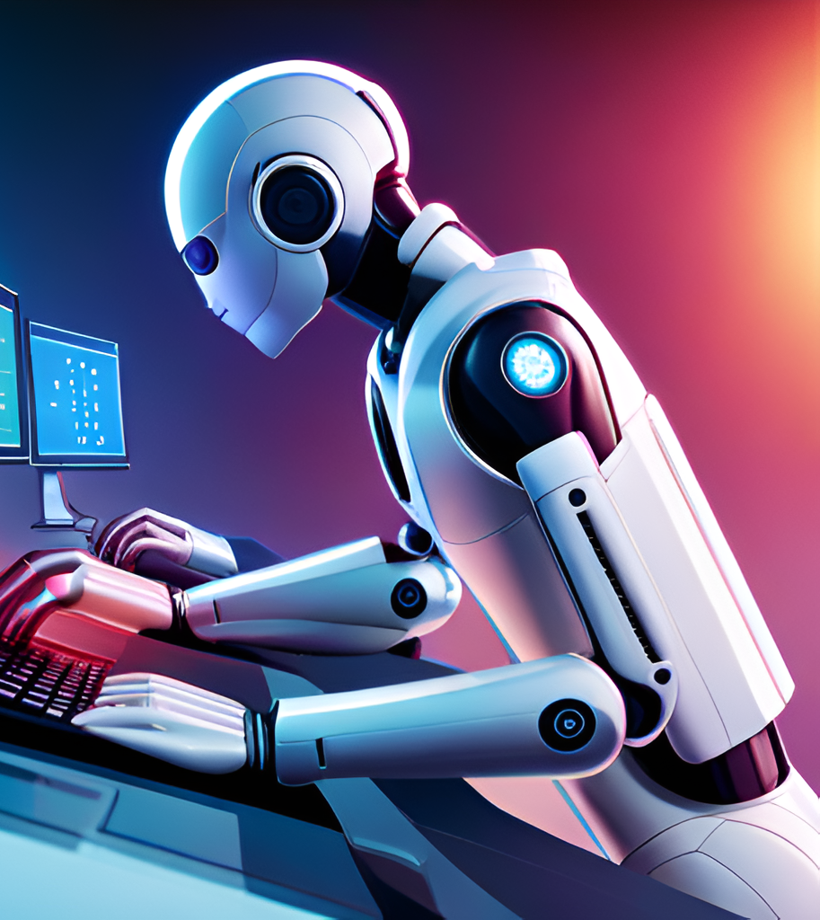
Robotic Process Automation
Robotic process automation (RPA) is a type of AI tool that automates repetitive tasks using software robots. It is often used in industries such as finance, insurance, and healthcare.
RPA can be used for a variety of tasks, such as data entry, invoice processing, and customer service. It allows businesses to save time and reduce errors, while also improving efficiency and productivity.

Slide 8
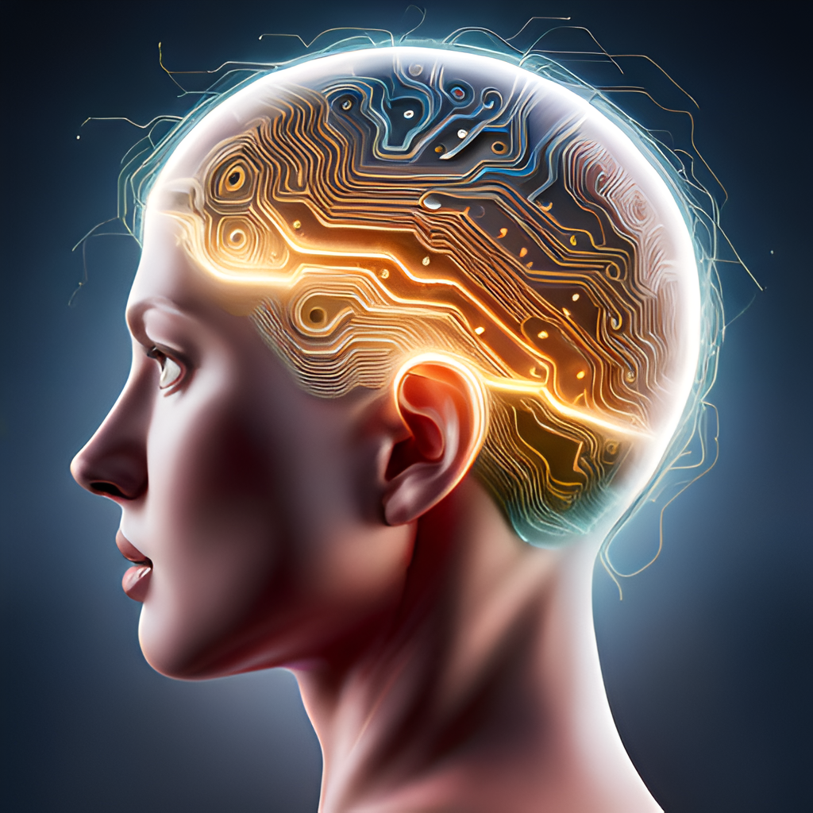
Machine Learning
Machine learning is a type of AI tool that allows computers to learn from data without being explicitly programmed. It involves creating algorithms that can identify patterns and make predictions based on large amounts of data.
Machine learning has many applications, such as image recognition, speech recognition, and recommendation systems. It is used in industries such as healthcare, finance, and e-commerce to improve decision-making and automate processes.

Slide 9
﻿
Thank you.
﻿
﻿
﻿
﻿
by Swapnil Patil

